Slide 1

Ziggy-food ordering system
Yuvraj Gage- 21104019
Soham Dalvi-21104010
Anurag Gupta-21104109
Sumit Gussain-21104022
Project Guide
Ms. Shweta Mahajan

Slide 2
Contents
Introduction
Objectives
Scope
Features / Functionality
Project Outcomes
Technology Stack
Block Diagram

Slide 3
1. Introduction
Problem Identified :
    The issue of eating outside food without going out?
Solution Proposed :
One of the main reasons to order food online is the convenience it provides. Customers can easily browse menus, place orders, and pay for their meals from the comfort of their own homes, without having to leave their house.

Slide 4
2. Objectives
To make local food restaurant easily accesable.
To reduce load on restaurant for delivery .
To make one stop solution for food ordering.
To build a user friendly application.
To provide contact less delivery.

Slide 5
3. Scope
Can be used for promoting new eatery.
Can be used to take feedbacks from customer to restaurant.

Slide 6
4.Features and functionalities
Features and functionality of our app :
Feature 1 :
    It is possible for people to see the Menu of that eatery.
Feature 2 :
    Users can use coupons to order.
Feature 3 :
    You can see the Opening time and closing time of
    Restaurant.
Feature 4 :
    You can add different payment types and multiple
    items can be selected at same times.

Slide 7
5. Outcome of Project
User Can log in
User can search for restaurents.
User can scroll through the menu.
User can choose the food they want to order from that
particular Menu.
User can choose the option to order online or cash on
delivery

Slide 8
6. Technology Stack
Python libraries used :
Tkinter
-MySQLdb
For backend :
1. My SQL

Slide 9
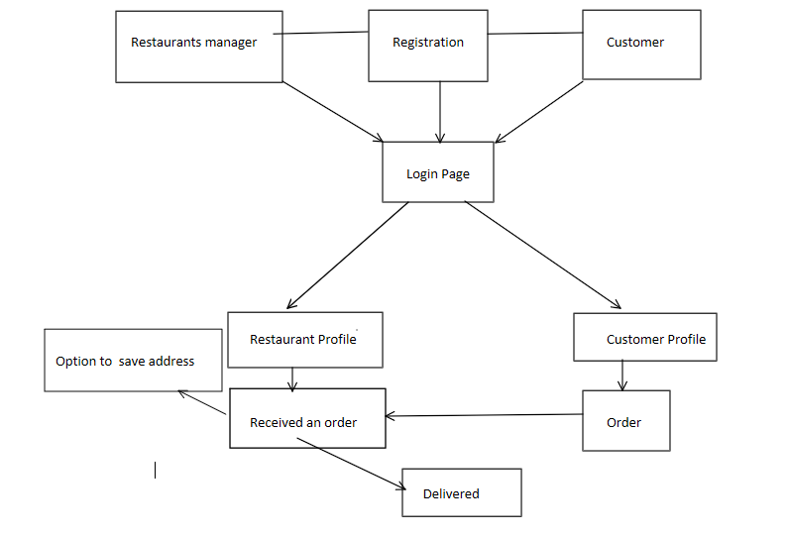
7. Block Diagram ( if applicable)

Slide 10
Thank You...!!

